Slide 1
Regional Optimization In Serialization (ROIS)
Kai Zhen
Lightning Talk for Novel Extensions to Inference Science Problems
Oct. 2024
Neural Efficiency Team

Slide 2
Agenda
“RO”: the come into being
Primitive pruning results
Perplexity
Zero-shot accuracy
Latency& memory reduction
Role of engagement w. AGI
Neural Efficiency Team

Slide 3
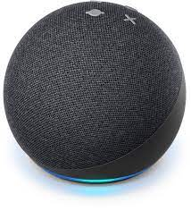
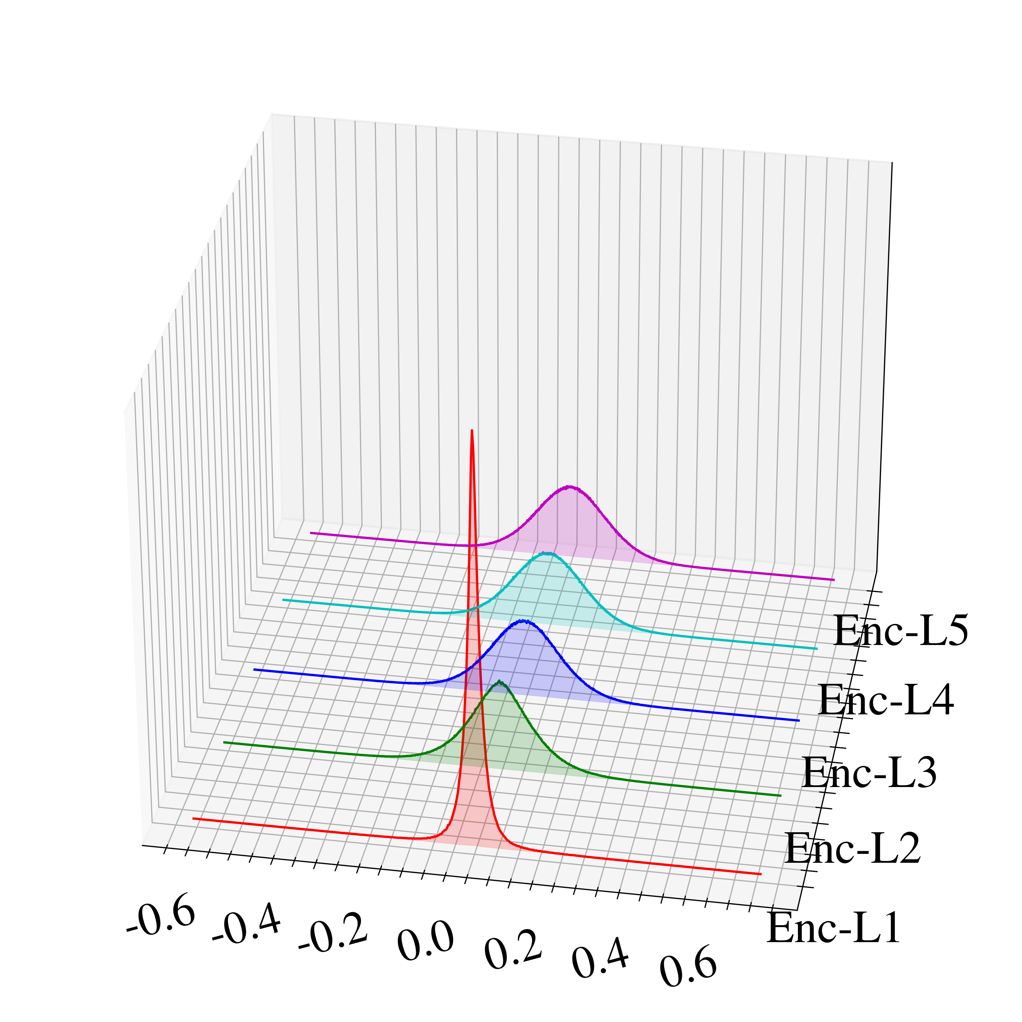
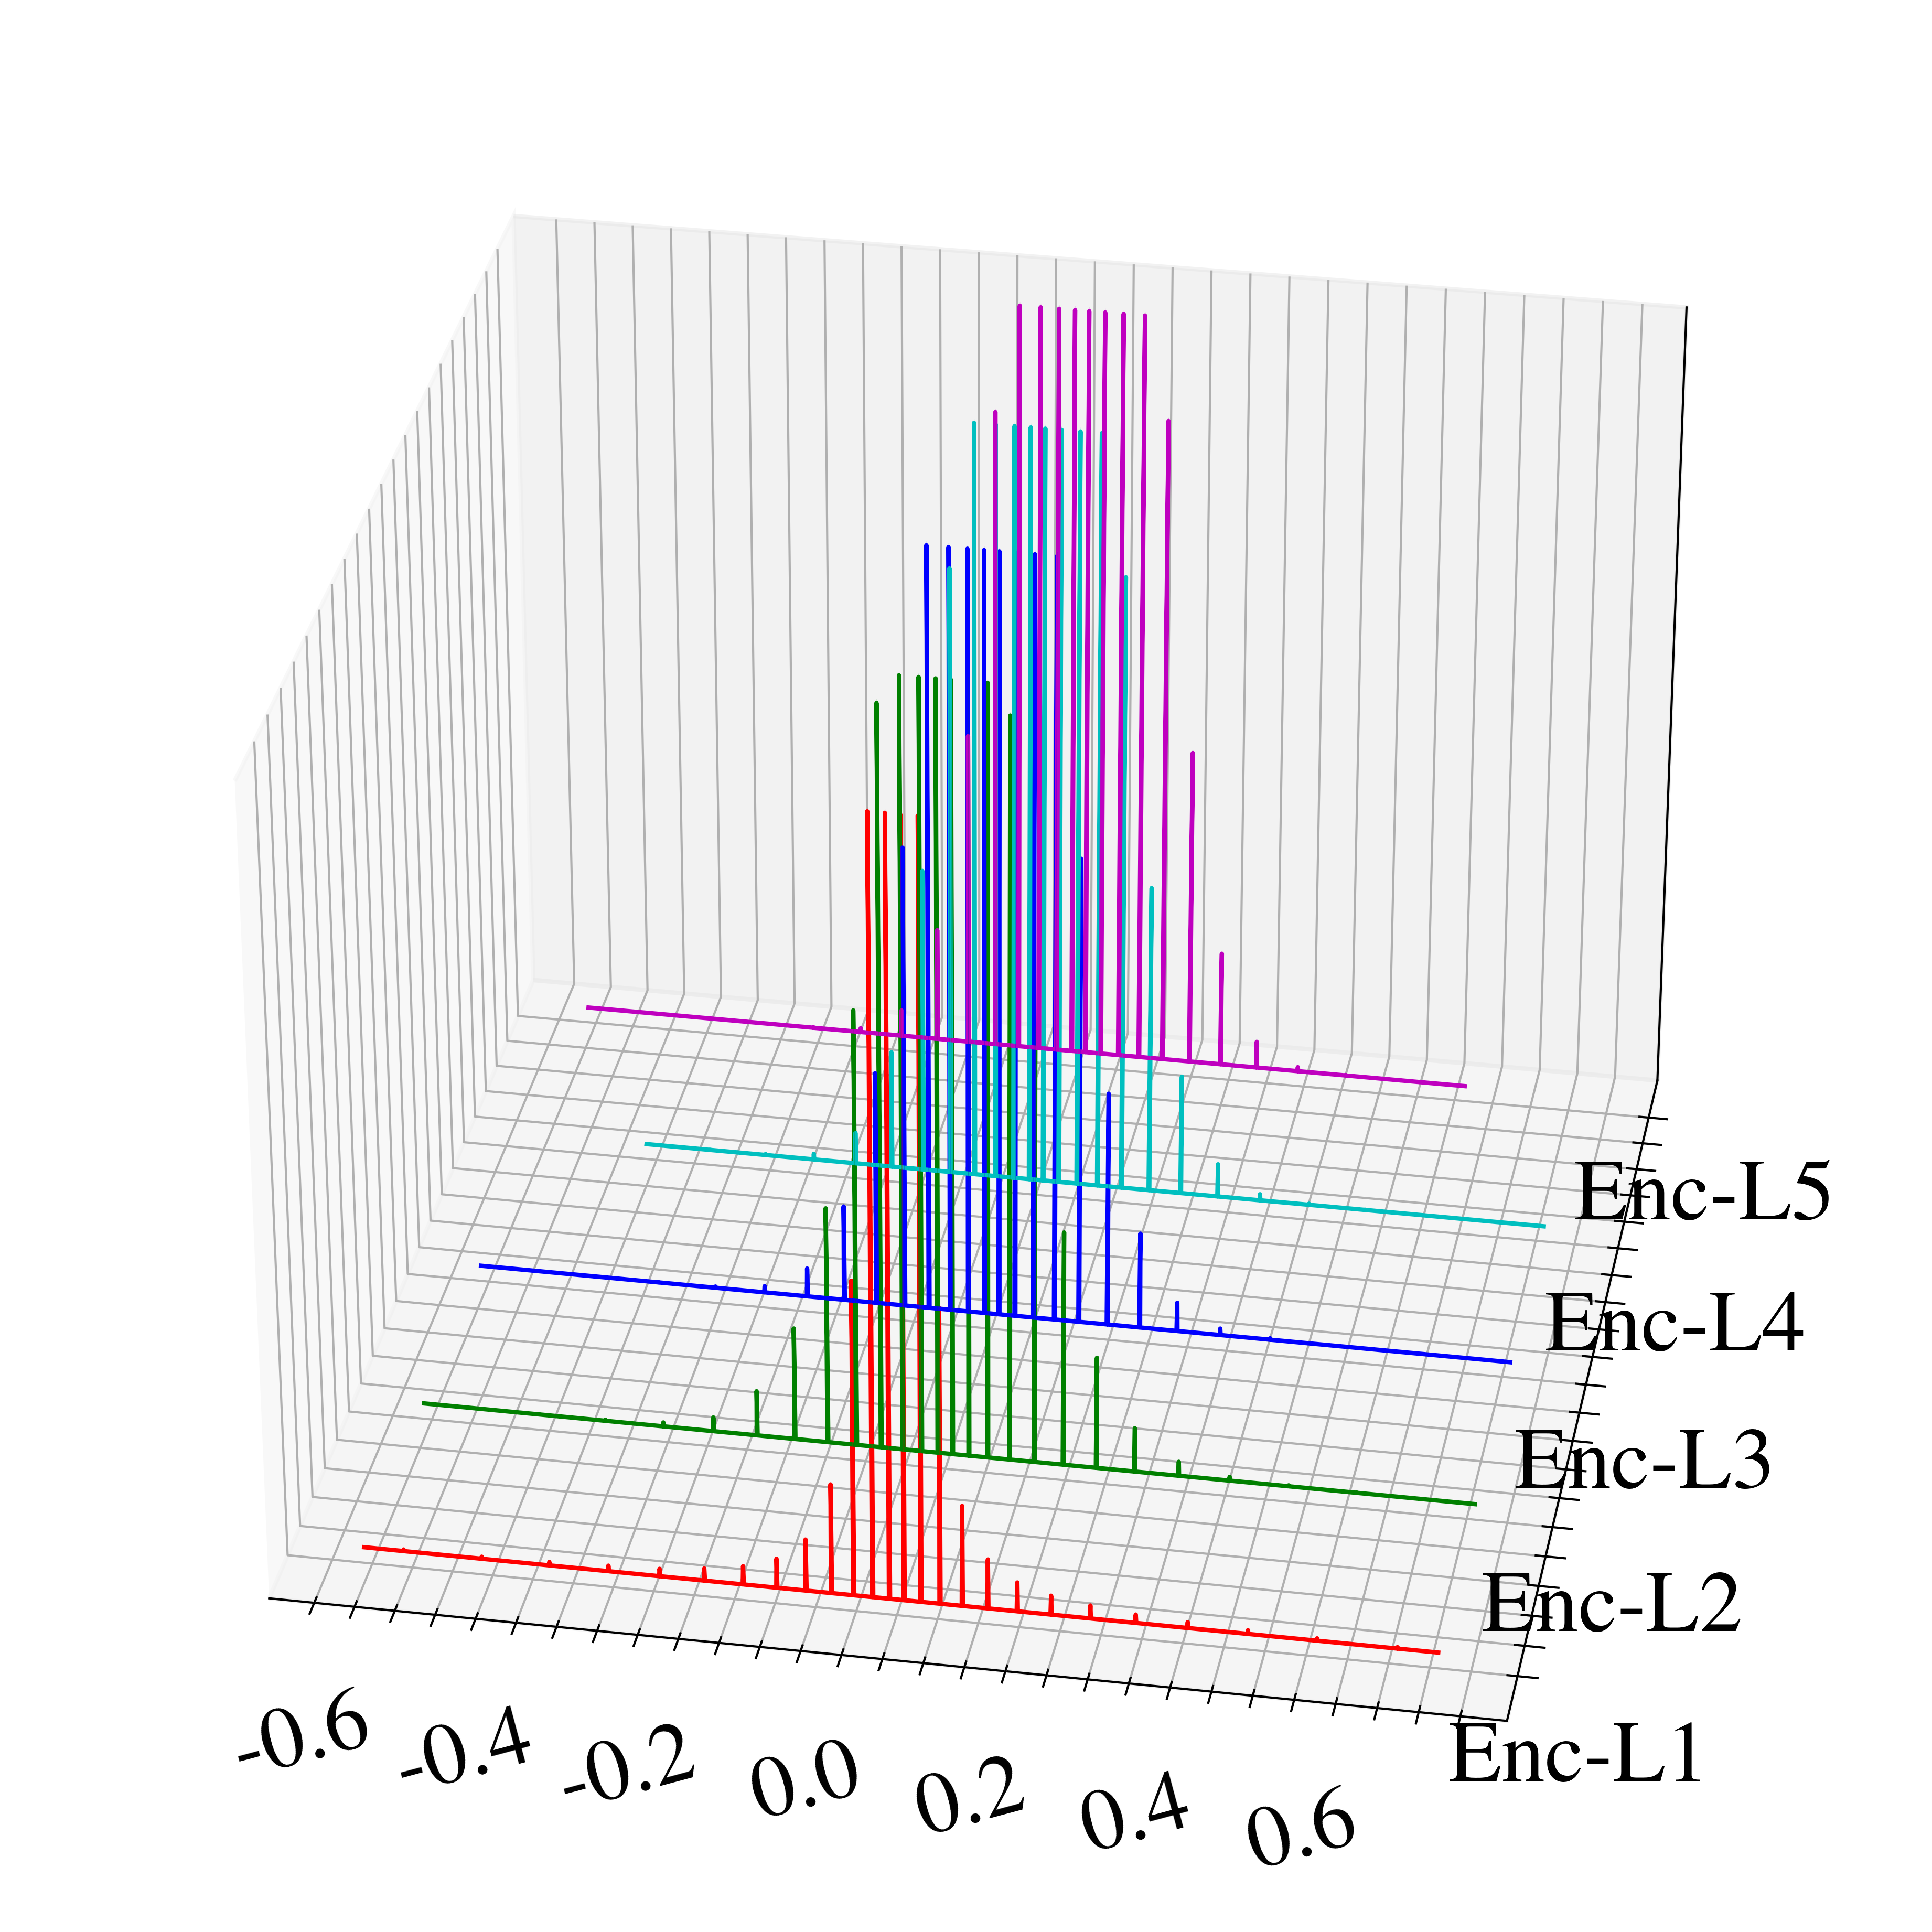
RO: the come into being
We had sub-8-bit quantization-aware training (S8BQAT)
If you’re able to crack the on-device ASR model on Echo & Echo Dot…
Weights are discretized: 31 unique weight values per matrix for 5-bit quantization
32-bit
5-bit
31 peaks
Neural Efficiency Team

Slide 4
RO: the come into being
We had sub-8-bit quantization-aware training (S8BQAT)
Hard to productize especially when we don’t own the model training: too expensive as it’s “in-training”!
~3 weeks to enable 8-bit Conformer for cloud ASR
6 p3.16xlarge instance
Neural Efficiency Team

Slide 5
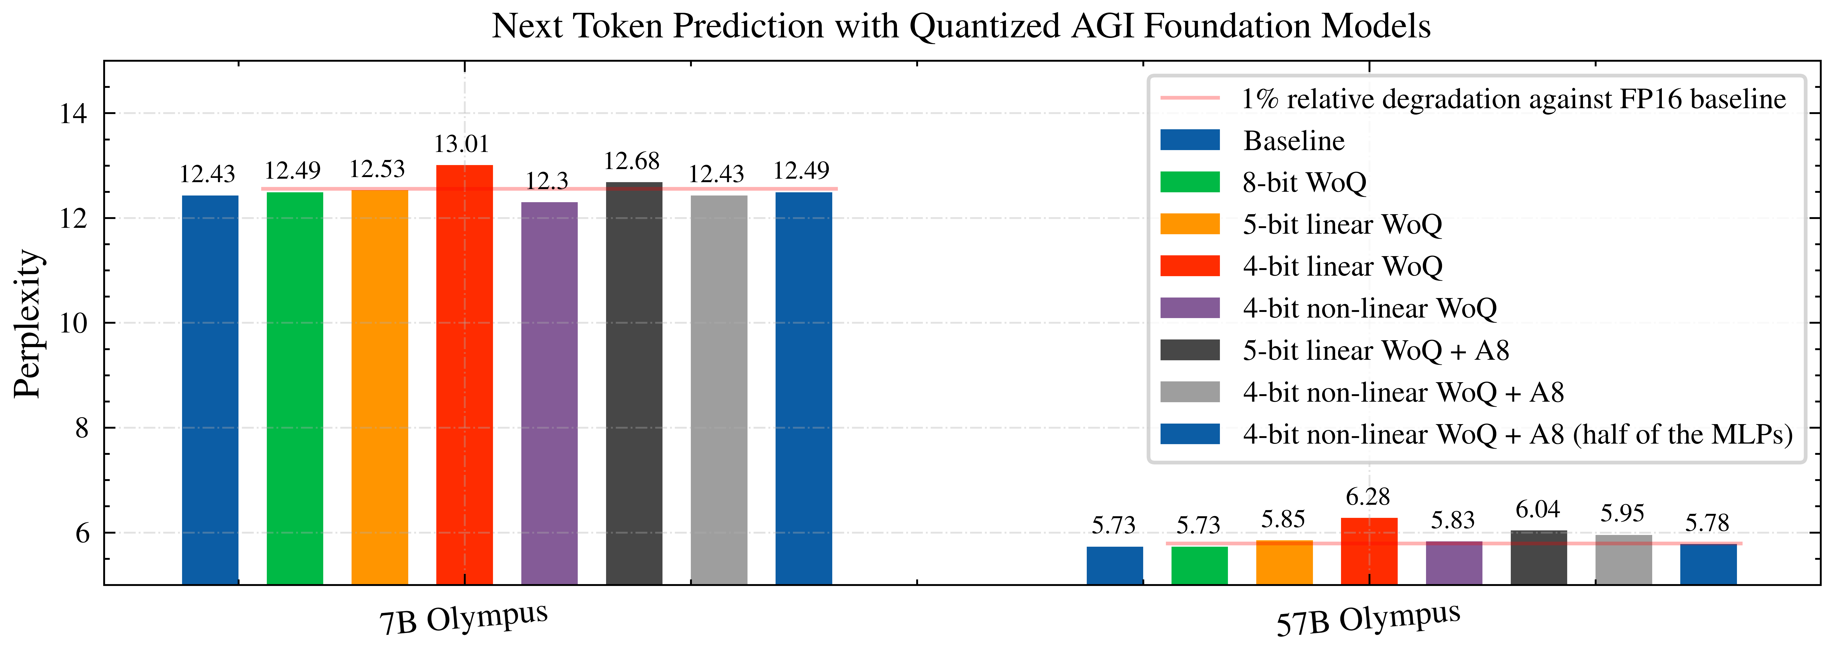
RO: the come into being
From in-training to post-training using per-layer wrapper
Per-layer:
Quantization:
Sufficient for 8-bit quantization (8-bit WoQ and Smooth Quant.)
Sub 4-bit quantization may lead to degradation.
Neural Efficiency Team
https://quip-amazon.com/JNUcAlvAzi2Q/AGI-Quantization

Slide 6
RO: the come into being
From in-training to post-training using per-layer wrapper
Per-layer:
Pruning:
Neural Efficiency Team

Slide 7


RO: the come into being
Tokens
Regional means neither global nor local
Linear
SiLU
Linear
Linear
RMSNorm
Linear
Dot-Prod Attn
Linear
RMSNorm
Tokens
Neural Efficiency Team

Slide 8
RO: the come into being
Regional means non-local neither
Neural Efficiency Team

Slide 9
Agenda
“RO”: the come into being
Primitive pruning results
Perplexity
Zero-shot accuracy
Latency & memory reduction
Role of engagement w. AGI
Neural Efficiency Team

Slide 10
Neural Efficiency Team

Slide 11
Neural Efficiency Team

Slide 12
Neural Efficiency Team

Slide 13
Neural Efficiency Team

Slide 14
Neural Efficiency Team

Slide 15
Neural Efficiency Team

Slide 16
Neural Efficiency Team

Slide 17
Better accuracy? Make your model bigger.
Accuracy
The bigger model may run slower.
Latency
Model Size
If the model size is too large, the model may not fit on device.
Simply increasing the number of parameters for better accuracy may significantly enlarge the model size and on-device latency!
Neural Efficiency Team

